Slide 1
DB. Normalization. MySQL, SQL.
Marta Kozak

Slide 2
What is a Database?
A database is an organized collection of structured information, or data, typically stored electronically in a computer system.
A database is a collection of information that is organized so that it can easily be accessed, managed, and updated.
Marta Kozak

Slide 3
Database VS Spreadsheet
Primary differences:
How the data is stored and manipulated
Who can access the data
How much data can be stored
Marta Kozak

Slide 4
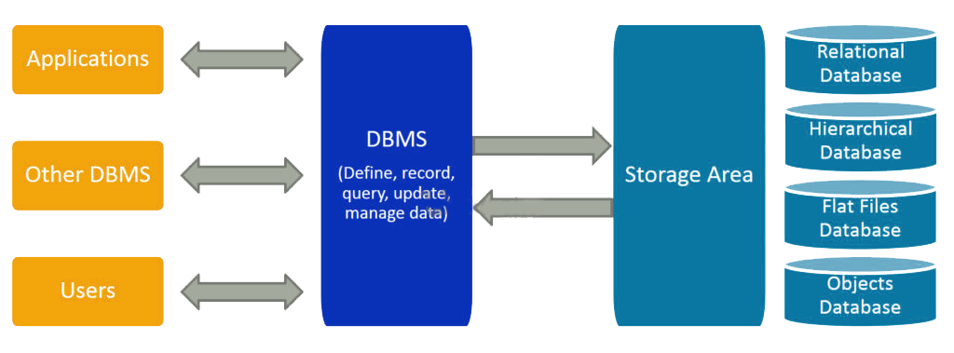
What is DBMS?
A DBMS serves as an interface between the database and its end users or programs.
Marta Kozak

Slide 5
DBMS Purpose:
To store data properly
To provide simultaneous access to the data for many users
To delimit the access to the data for different users
To allow users to retrieve, update, and manage how the information is organized and optimized.
To prevent data from loss
Marta Kozak

Slide 6
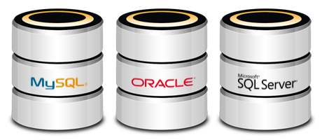
Popular DBMSs:
MySQL
Microsoft SQL Server
Microsoft Access
Oracle
PostgreSQL
Marta Kozak

Slide 7

Application or Function of DBMS
Banking: all transactions
Airlines: reservations, schedules
Universities: registration, grades
Online retailers: order tracking, customized recommendations
Human resources: employee records, salaries, tax deductions
Marta Kozak

Slide 8
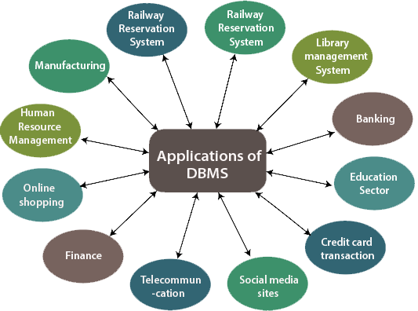
Marta Kozak

Slide 9
Types of Databases
Marta Kozak

Slide 10
Hierarchical databases
this model represents one- to- many relationships
data is represented in the tree-like structure
only one parent for each child node
parent nodes can have more than one child
not very flexible to reorganize the model.
Marta Kozak

Slide 11
Root Node
s_id s_name s_age
101 | Yurii | 20
232 | Maria | 18
244 | Oleh | 20
t2 | Task_2
t3 | Task_3
t_id t_name
t1 | Task_1
t4 | Task_4
t5 | Task_5
Marta Kozak

Slide 12
Network databases
Supports many to many relationships.
Many parents can have many children. Many children can have many parents.
Entities are represented as a connected network with each other.
Not very flexible to reorganize the model.
Marta Kozak

Slide 13
University
Applied Mathematics Department
Electronics
Department
Room 365
Room 111
Computer
Lab
Room 321
Marta Kozak

Slide 14
Object-oriented databases
data is represented in the form of objects, as used in OOP.
Marta Kozak

Slide 15
Shape
Circle
Center
Radius
Rectangle
Length
Height
Triangle
Base
Height
Marta Kozak

Slide 16
Relational databases
uses a structure that allows us to identify and access data in relation to another piece of data in the database.
represents the database as a collection of relations (tables)
Marta Kozak

Slide 17
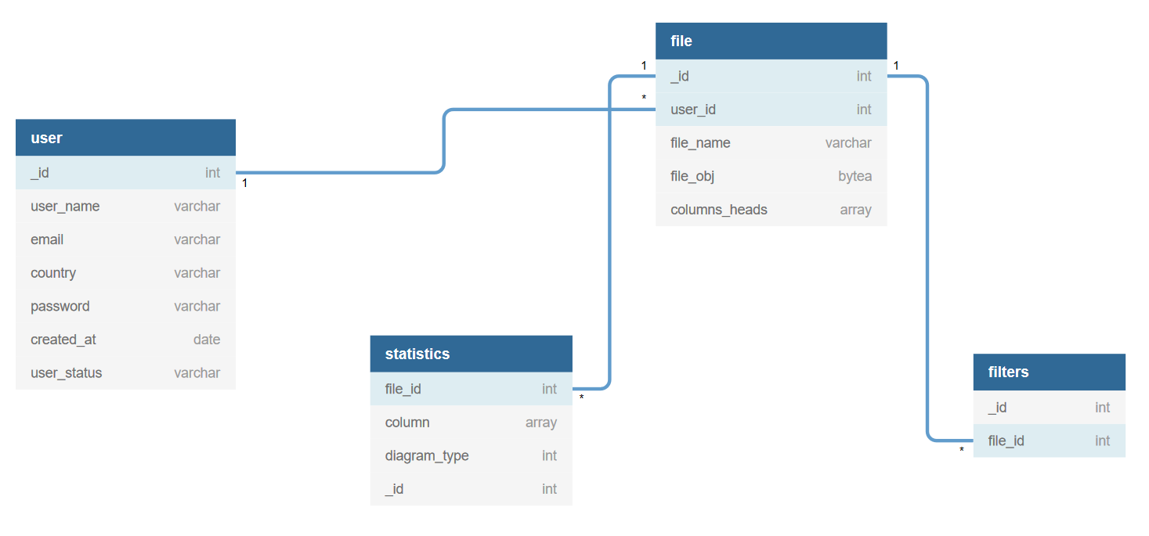
Marta Kozak

Slide 18
Database normalization
Marta Kozak

Slide 19
First Normal Form (1NF)
Single Valued Attributes
Attribute Domain should not change
Unique name for Attributes/Columns
Order doesn't matters
Marta Kozak

Slide 20
id | name | subject
144 | Boris | C++, C#
145 | Olesya | Java, Ruby
146 | Oleh | Python
Not in the 1NF
id | name | subject
144 | Boris | C++
144 | Boris | C#
145 | Olesya | Java
145 | Olesya | Ruby
146 | Oleh | Python
Satisfies the 1NF
Marta Kozak

Slide 21
Second Normal Form (2NF)
Table should be in the First Normal form.
Table should not have Partial Dependency.
Marta Kozak

Slide 22
teacher_id | name | subject
11 | Roman | History
12 | Jan | Physics
12 | Jan | Maths
13 | Oleksandr | English
Not in the 2NF
teacher_id | subject
11 | History
12 | Physics
12 | Maths
13 | English
Satisfies the 2NF
teacher_id | name
11 | Roman
12 | Jan
13 | Oleksandr
Marta Kozak

Slide 23
Third Normal Form (3NF)
Table is in the Second Normal form.
Table doesn't have Transitive Dependency.
Marta Kozak

Slide 24
PK
Guest | Hotel | Price
Johnson | Marriott | 2300
Steinberg | Hilton | 4000
Pavlov | Radisson | 2500
Not in the 3NF
PK
Hotel | Price
Marriott | 2300
Hilton | 4000
Radisson | 2500
PK
Guest | Hotel
Johnson | Marriott
Steinberg | Hilton
Pavlov | Radisson
Satisfies the 3NF
Marta Kozak
FK

Slide 25
SQL
Marta Kozak

Slide 26
General information
SQL stands for Structured Query Language
It is a computer language that is used to interact with and manage a database.
It is the most widely used language used to manage databases.
One thing that is important to note is that SQL is not a specific database system, there are many database systems that use SQL.

Slide 27
Commands:
Data Definition Language (DDL): Related to the data structure.
Create
Drop
Alter
Data Manipulation Language (DML): Related to stored data.
Select
Insert
Update
Delete
Data Control Language (DCL):
GRANT
DENY
REVOKE

Slide 28


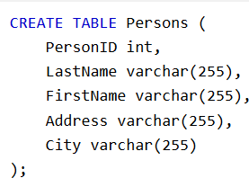

Creates a database textDB
Deletes a database textDB
Creates a table with columns listed
Addes a column to an existing table
Marta Kozak

Slide 29



Selects listed columns from a table
Selects all the columns from a table
Inserts a new record
Changes the record, where CustomerID=1
Deletes the customer "Alfreds Futterkiste" from the table

Slide 30
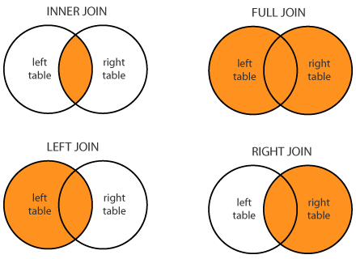
SQL JOINs

Slide 31
workers
departments
id | name | dep_id
1 | George | 100
2 | Anna | 101
3 | Max | 150
4 | Iryna | 120
dep_id | dep_name
100 | Sales
101 | Support
102 | Logistics
103 | Finances
SELECT workers.name, departments.dep_name
FROM workers
INNER JOIN departments ON workers.dep_id = departments.dep_id
name | dep_name
George | Sales
Anna | Support
Marta Kozak

Slide 32
workers
departments
id | name | dep_id
1 | George | 100
2 | Anna | 101
3 | Max | 150
4 | Iryna | 120
dep_id | dep_name
100 | Sales
101 | Support
102 | Logistics
103 | Finances
SELECT workers.name, departments.dep_name
FROM workers
LEFT OUTER JOIN departments ON workers.dep_id = departments.dep_id
name | dep_name
George | Sales
Anna | Support
Max | NULL
Iryna | NULL
Marta Kozak

Slide 33
workers
departments
id | name | dep_id
1 | George | 100
2 | Anna | 101
3 | Max | 150
4 | Iryna | 120
dep_id | dep_name
100 | Sales
101 | Support
102 | Logistics
103 | Finances
SELECT workers.name, departments.dep_name
FROM workers
RIGHT OUTER JOIN departments ON workers.dep_id = departments.dep_id
name | dep_name
George | Sales
Anna | Support
NULL | Logistics
NULL | Finances
Marta Kozak

Slide 34
workers
departments
id | name | dep_id
1 | George | 100
2 | Anna | 101
3 | Max | 150
4 | Iryna | 120
dep_id | dep_name
100 | Sales
101 | Support
102 | Logistics
103 | Finances
SELECT workers.name, departments.dep_name
FROM workers
FULL OUTER JOIN departments ON workers.dep_id = departments.dep_id
name | dep_name
George | Sales
Anna | Support
Max | NULL
Iryna | NULL
NULL | Logistics
NULL | Finances
Marta Kozak

Slide 35
MySQL Database
MySQL is a fast, easy-to-use RDBMS
MySQL is released under an open-source license.
MySQL uses a standard form of the well-known SQL data language.
MySQL works on many operating systems and with many languages including PHP, PERL, C, C++, JAVA, etc.
MySQL works very quickly and works well even with large data sets.
MySQL supports large databases, up to 50 million rows or more in a table. The default file size limit for a table is 4GB, but you can increase this (if your operating system can handle it) to a theoretical limit of 8 million terabytes (TB).
MySQL is customizable. The open-source GPL license allows programmers to modify the MySQL software to fit their own specific environments.

Slide 36
Thanks for attention! ☺
Marta Kozak

